Slide 1




Indian Institute Of Information Technology, Lucknow
Presentation 2023
AGILE PROJECT MANAGMENT
Presented by
Dyovan Madhav (MDB23024)
Presented to
Dr. Rudra Rameshwar

Slide 2

Content
What is Agile Management
Agile Development Cycle
Agile Principles
Methodologies
Achievements
Case Studies
Conclusion

Slide 3






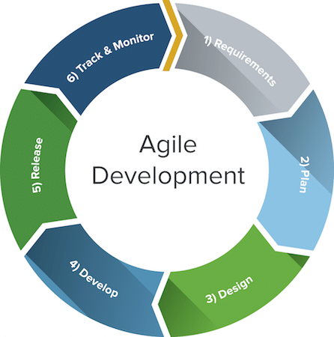
What is Agile Management
It is a flexible approach to project management that emphasizes collaboration, adaptability, and iterative development.

Slide 4



AGILE DEVELOPMENT CYCLE

Slide 5





Agile development cycle
Project team comes together For identification and assignment
Planning
Requirement analysis
Key stakeholders and users meet
Design
The design is prepared from the requirements identified
Development
Coding or developing features

Slide 6
Agile development cycle
Test the code against the requirements
Testing
Deliver the product to customers
Deployment

Slide 7
AGILE PRINCIPLES

Slide 8
Satisfy the customers
Agile Principles
Welcome changing requirements
Deliver working software
Ensure technical excellence
Work together
Simplicity
Build around motivated individuals
Self organizing teams
Face to face conversation
Reflect and adjustment
Focus on working software
Promote sustainable development

Slide 9
ADVANTAGES AND DISADVANTAGES

Slide 10

ADVANTAGES
Fast high quality delivery
Change and Continuous improvement is embraced
Strong team interaction
Customers are heard
End goal is identified

Slide 11
DISADVANTAGES
Planning can be less concrete
Time commitment from developers is required
Team must be knowledgeable

Slide 12
AGILE METHODOLOGIES

Slide 13
SCRUM METHODOLOGY
Scrum is an Agile project management methodology involving a small team led by a Scrum master, whose main job is to remove all obstacles to getting work done.
Work is done in short cycles called sprints, and the team meets daily to discuss current tasks and any roadblocks that need clearing.

Slide 14
SCRUM ROLES
Product Owner
Scrum Master
Scrum Team
The Scrum Product Owner has the vision of what to build and conveys that to the team.
The Scrum Master helps the team do their best possible work.
The Scrum Team is comprised of five to seven members.
Everyone on the project completes the set of work together

Slide 15
KANBAN METHODOLOGY
It is Japanese for “card.” It is a visual framework used to implement Agile and shows what to produce, when to produce it, and how much to produce.

Slide 16
Core Principles of Kanban
Visualise the workflow
01
Limit work in progress
02
Manage and enhance the flow
03
Make process policies explicit
04
Continuously improve
05

Slide 17

XP
Extreme Programming
FDD
Feauture driven development
Other Agile methodologies
ASD
Adaptive system development
LSD
Lean Software Development

Slide 18


Case Study
Adoption of Agile methodologies in their software development processes

Slide 19
Reference
https://www.researchgate.net/publication/221592363_Agile_Project_Management
https://www.wrike.com/project-management-guide
https://en.wikipedia.org/wiki/Agile_management

Slide 20
Conclusion
By embracing flexibility, iterative development, and continuous improvement, Agile empowers teams to adapt, innovate, and deliver high-quality products or services efficiently.
Its core principles of customer collaboration, responding to change, and fostering a motivated team drive success in delivering valuable outcomes.

Slide 21




Indian Institute Of Information Technology , Lucknow
THANK YOU
Dyovan Madhav
9544357424
mdb23024@iiitl.ac.in
http://www.linkedin.com/in/dyovan-madhav

